Slide 1



VN Habit Tracker
VHT
Supervisor: - Lai Duc Hung
Members: - Luu Thanh Dat - Leader - Pham Thanh Tung

Slide 2
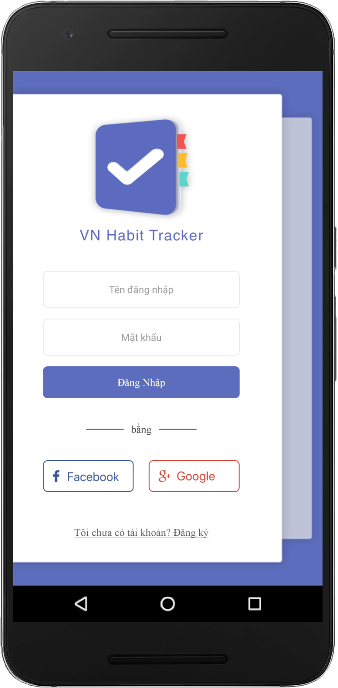

01
Introduction
02
Issues
03
CONTENT
Idea & Solution
04
Outcome
05
Future Plan
06
Q & A

Slide 3

1. Introduction
What?
Why?
How?

Slide 4

1. Introduction
Children
What?
Why?
How?
Đánh răng
Dậy sớm
Học tập
Phát triển bản thân
Gia đình & xã hội

Slide 5

1. Introduction
Student
What?
Why?
How?
Đánh răng
Dậy sớm
Học tập
Phát triển bản thân
Gia đình & xã hội

Slide 6

1. Introduction
Adult
What?
Why?
How?
Đánh răng
Dậy sớm
Học tập
Phát triển bản thân
Gia đình & xã hội
Công việc

Slide 7
Adult
Business Logic
1. Introduction
countable
yes/no

Slide 8

1. Introduction
What?
Why?
How?

Slide 9


1. Introduction
What?
Why?
How?

Slide 10






2. Issues
z

Slide 11



2. Issues

Slide 12








2. Issues

Slide 13

3. Idea & Solution
What?
Why?
How?

Slide 14
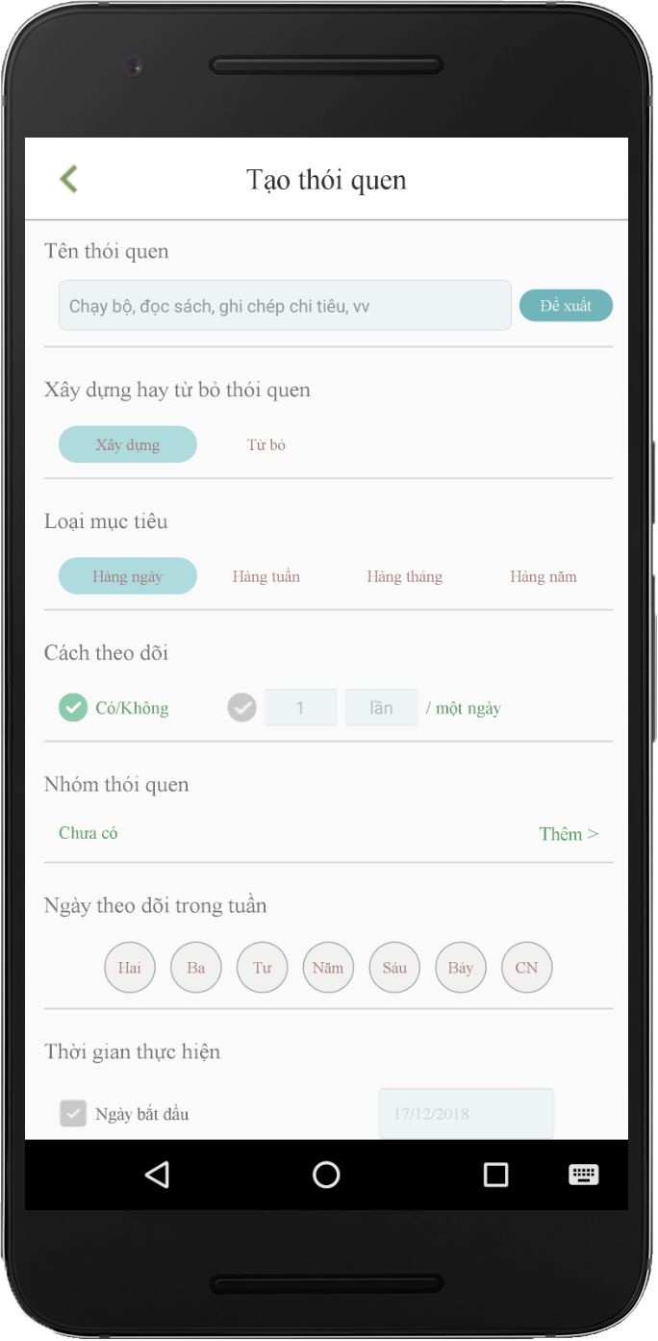

Create Habit
Business Logic
Algorithm
..v..v..

Slide 15
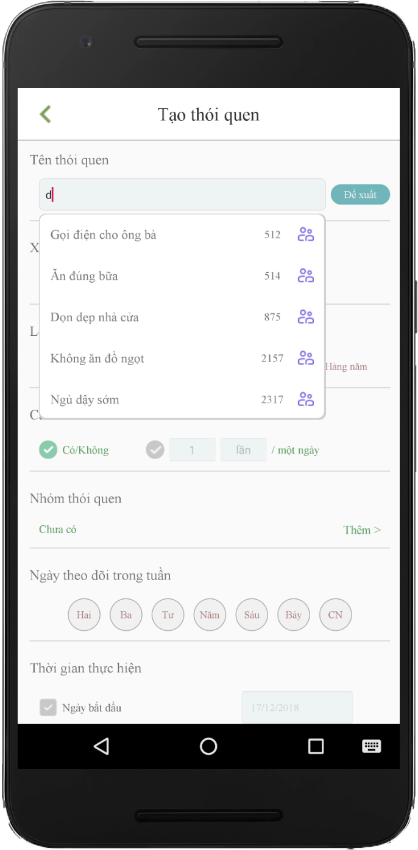
Create Habit
Business Logic
Algorithm
..v..v..

Slide 16
Suggest Habit
Business Logic
Algorithm
..v..v..

Slide 17
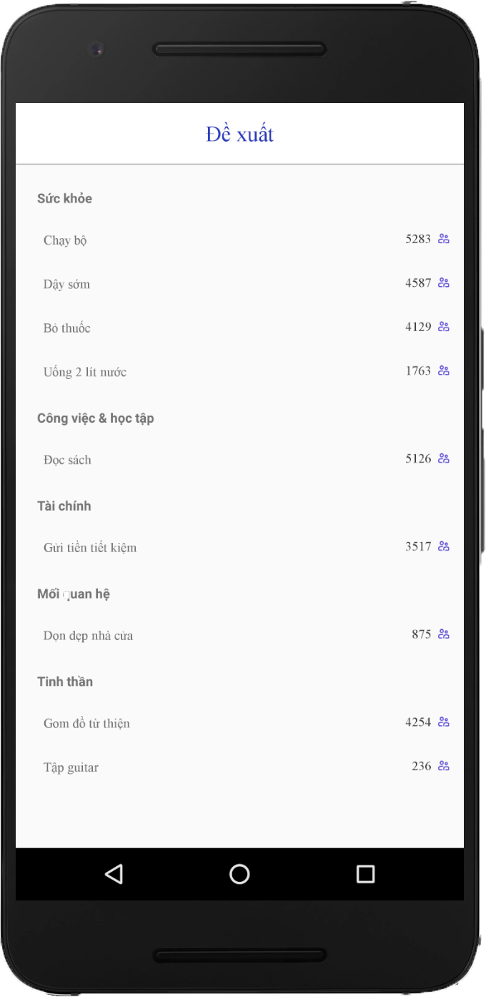
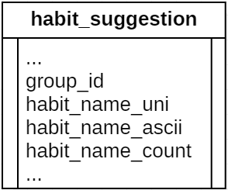
Suggest Habit
compare
have
+ 1
not have
Add New

Slide 18
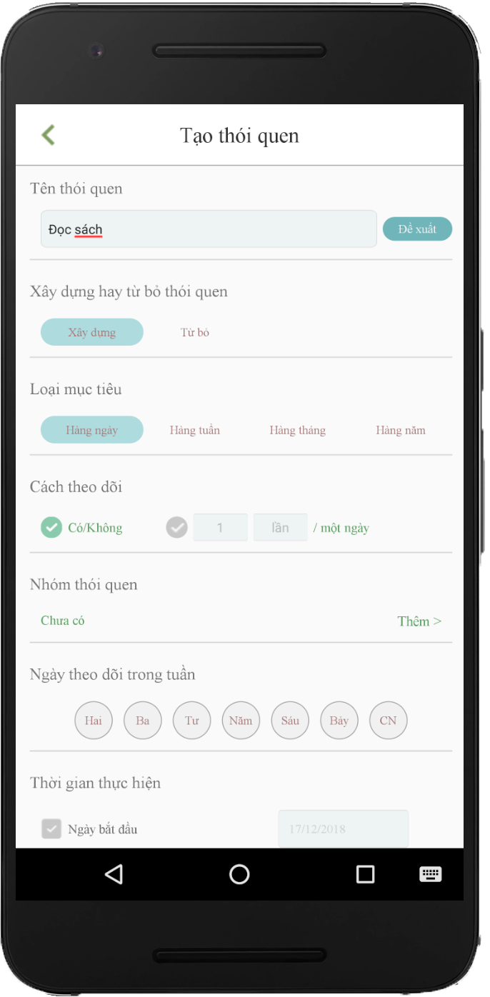
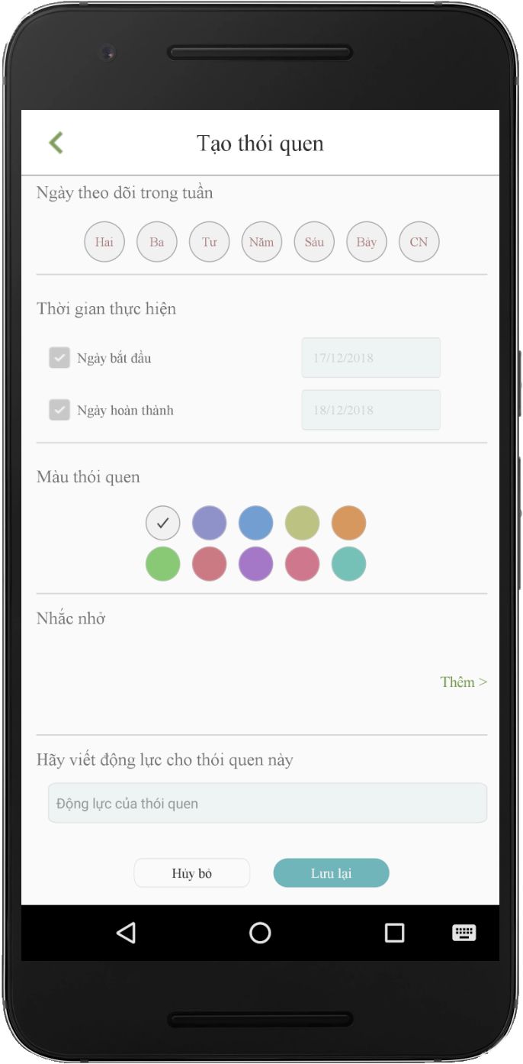
Create Habit
Build/quit
Daily/weekly/monthly/yearly
Yes/no - countable
Group
Day in week
Set time goal
Color
Reminders
Note/ motivation

Slide 19

3. Idea & Solution

Slide 20

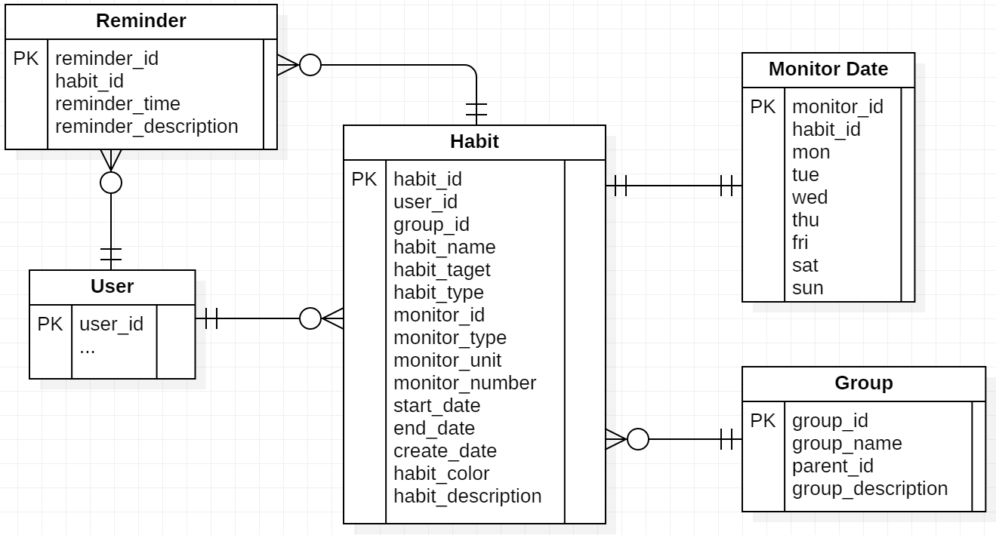
3. Idea & Solution
How?

Slide 21
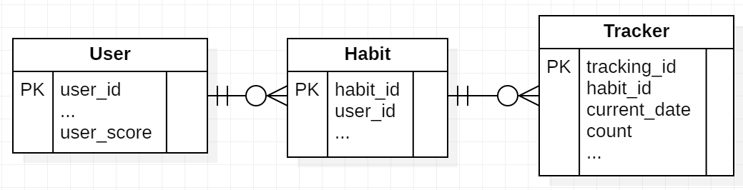
3. Idea & Solution
How?

Slide 22



3. Idea & Solution
$f\left(x\right)=t+d\left(x\right)+c\left(x\right)$ $∀x ∈\{1,2,3\}$

Slide 23
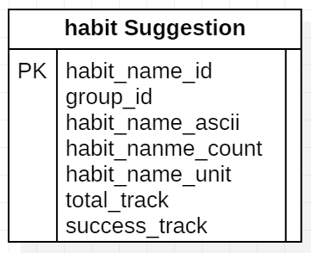
3. Idea & Solution
build/quit
countable
Success
Daily
Weekly
Monthly
Yearly
yes/no

Slide 24
3. Idea & Solution
$f\left(x\right)=t+d\left(x\right)+c\left(x\right)$ $∀x ∈\{1,2,3\}$

Slide 25

3. Idea & Solution
Daily
Weekly
Monthly
Yearly
n = 2(n-1) + (n – 2)
+ score
7 days: +2
30 days: +4
60 days: +8
180 days: +18
360 days: +32
Level 1 – 3: easy
Level 4 – 6: medium
Level > 6: hard

Slide 26
3. Idea & Solution
$f\left(x\right)=t+d\left(x\right)+c\left(x\right)$ $∀x ∈\{1,2,3\}$

Slide 27
3. Idea & Solution

Slide 28
4. Outcome

Slide 29
5. Future Plan

Slide 30






Add title text
Here is a brief description of some of the text, as simple as possible.
01
Add title text
introduction-Background
Here is a brief description of some of the text, as simple as possible.
Add title text
Here is a brief description of some of the text, as simple as possible.

Slide 31
01
keyword
keyword
keyword
keyword
introduction-Research significance
1
2
3
4
Add title text
Add title text
Add title text
Add title text
Here is a brief description of some of the text, as simple as possible.
Here is a brief description of some of the text, as simple as possible.
Here is a brief description of some of the text, as simple as possible.
Here is a brief description of some of the text, as simple as possible.

Slide 32
01
introduction-Research Review
Add title text
Add title text
Here is a brief description of some of the text, as simple as possible.
Add title text
Here is a brief description of some of the text, as simple as possible.
Here is a brief description of some of the text, as simple as possible.
Add title text
Add title text
Here is a brief description of some of the text, as simple as possible.
Here is a brief description of some of the text, as simple as possible.
2013
2014
2015
2016
2017

Slide 33
Add title text
01
Here is a brief description of some of the text, as simple as possible.
introduction-Literature review
Add title text
Add title text
Here is a brief description of some of the text, as simple as possible.
Here is a brief description of some of the text, as simple as possible.
Add title text
Add title text
Here is a brief description of some of the text, as simple as possible.
Here is a brief description of some of the text, as simple as possible.

Slide 34


01
Add title text
Add title text
Here is a brief description of some of the text, as simple as possible.
Here is a brief description of some of the text, as simple as possible.
introduction-The main contribution
Add title text
Add title text
Here is a brief description of some of the text, as simple as possible.
Here is a brief description of some of the text, as simple as possible.

Slide 35



PART TWO
Research methods and ideas
01
Research ideas
Here is a brief description of some of the text, as simple as possible.
02
Research scheme
Here is a brief description of some of the text, as simple as possible.
03
Study plan feasibility
Here is a brief description of some of the text, as simple as possible.

Slide 36


02
Research ideas and methods - research ideas
Add title text
Add title text
Here is a brief description of some of the text, as simple as possible.
Here is a brief description of some of the text, as simple as possible.
Add title text
Add title text
Here is a brief description of some of the text, as simple as possible.
Here is a brief description of some of the text, as simple as possible.

Slide 37

02
Add title text
Add title text
Research ideas and methods-Research scheme
Here is a brief description of some of the text, as simple as possible.
Here is a brief description of some of the text, as simple as possible.
Add title text
Add title text
Here is a brief description of some of the text, as simple as possible.
Here is a brief description of some of the text, as simple as possible.

Slide 38
1
Description one
Here is a brief description of some of the text, as simple as possible.
02
2
Study plan feasibility
1
Description two
Here is a brief description of some of the text, as simple as possible.
3
2
4
Description three
Here is a brief description of some of the text, as simple as possible.
3
Add title text
Description four
Here is a brief description of some of the text, as simple as possible.
4

Slide 39
PART THREE
Key technologies and practical difficulties
01
Key technology
Here is a brief description of some of the text, as simple as possible.
02
Practical difficulties
Here is a brief description of some of the text, as simple as possible.
03
Case comparison analysis
Here is a brief description of some of the text, as simple as possible.

Slide 40
03
+
Add title text Here is a brief description of some of the text, as simple as possible.
Key technologies and practical difficulties
+
Add title text
Here is a brief description of some of the text, as simple as possible.
+
Add title text Here is a brief description of some of the text, as simple as possible.

Slide 41
03
Add title text
Key technologies and practical difficulties
Add title text
title
Here is a brief description of some of the text, as simple as possible.
Here is a brief description of some of the text, as simple as possible.
45%
keyword
55%
Add title text
Here is a brief description of some of the text, as simple as possible.Here is a brief description of some of the text, as simple as possible.

Slide 42
03
Key technologies and practical difficulties
Add title text
Add title text
Here is a brief description of some of the text, as simple as possible.
Here is a brief description of some of the text, as simple as possible.
Add title text
Add title text
Here is a brief description of some of the text, as simple as possible.
Here is a brief description of some of the text, as simple as possible.

Slide 43
PART FOUR
Research results and applications
01
Research objectives
Here is a brief description of some of the text, as simple as possible.
02
Form of result
Here is a brief description of some of the text, as simple as possible.
03
Application prospect
Here is a brief description of some of the text, as simple as possible.

Slide 44
04
Here is a brief description of some of the text, as simple as possible.
4
Research results and applications
1
Here is a brief description of some of the text, as simple as possible.
Here is a brief description of some of the text, as simple as possible.
Here is a brief description of some of the text, as simple as possible.
5
2
Here is a brief description of some of the text, as simple as possible.
Here is a brief description of some of the text, as simple as possible.
6
3

Slide 45

04
Add title text
Here is a brief description of some of the text, as simple as possible.
Research results and applications
Add title text
Here is a brief description of some of the text, as simple as possible.

Slide 46
04
Research results and applications
Here is a brief description of some of the text, as simple as possible.
Here is a brief description of some of the text, as simple as possible.
Here is a brief description of some of the text, as simple as possible.
Here is a brief description of some of the text, as simple as possible.
Here is a brief description of some of the text, as simple as possible.
Here is a brief description of some of the text, as simple as possible.

Slide 47
PART FIVE
Related suggestions
01
Case comparison analysis
Here is a brief description of some of the text, as simple as possible.
02
Problem assessment
Here is a brief description of some of the text, as simple as possible.
03
Related measures
Here is a brief description of some of the text, as simple as possible.

Slide 48
05
Add title text
Add title text
Here is a brief description of some of the text, as simple as possible.
Here is a brief description of some of the text, as simple as possible.
Related suggestions- Case comparison analysis
Add title text
Add title text
Here is a brief description of some of the text, as simple as possible.
Here is a brief description of some of the text, as simple as possible.

Slide 49
05
01
02
03
04
Related suggestions-Problem assessment
Add title text
Add title text
Add title text
Add title text
Here is a brief description of some of the text, as simple as possible.
Here is a brief description of some of the text, as simple as possible.
Here is a brief description of some of the text, as simple as possible.
Here is a brief description of some of the text, as simple as possible.

Slide 50
Here is a brief description of some of the text, as simple as possible.
05
02
Related suggestions-Related measures
Here is a brief description of some of the text, as simple as possible.
Here is a brief description of some of the text, as simple as possible.
01
03
Title text
Here is a brief description of some of the text, as simple as possible.
05
04
Here is a brief description of some of the text, as simple as possible.

Slide 51
PART SIX
Paper summary
01
Research methods
Here is a brief description of some of the text, as simple as possible.
02
Achievements and thinking
Here is a brief description of some of the text, as simple as possible.

Slide 52



06
Paper summary-Research methods
Add title
Add title
Add title
Here is a brief description of some of the text, as simple as possible.
Here is a brief description of some of the text, as simple as possible.
Here is a brief description of some of the text, as simple as possible.

Slide 53

06
Paper summary-Achievements and thinking
Add title
Add title
Add title
Here is a brief description of some of the text, as simple as possible.
Here is a brief description of some of the text, as simple as possible.
Here is a brief description of some of the text, as simple as possible.

Slide 54


SMALL FRESH
THESIS DEFENSE TEMPLATE
THANK YOU
School of Economics and Management,
marketing professional level 2018

